Slide 1
Industrial Human Resource Geo-Visualization

Slide 2
Problem Statement
The current workforce data in India is outdated, impacting accurate insights into labor distribution across industries.
This project aims to refresh this data to reflect the true economic status and employment trends, especially excluding agricultural sectors

Slide 3
Objective
To update and analyze the industrial classification of main and marginal workers in India, categorized by sex, section, division, and class.
Provide relevant and up-to-date data for policymakers and employment planning.

Slide 4
Purpose
Deliver an accurate classification of workforce data that can drive policy decisions.
Enhance employment planning and optimize the industrial workforce distribution.

Slide 5
Uses and Applications
Applications: Policy planning, employment trend analysis, labor distribution studies.
Uses: Data can be used by government agencies, economists, and business analysts to assess industrial workforce dynamics

Slide 6
Technologies and Tools Used
Technologies: Exploratory Data Analysis (EDA), Visualization, Natural Language Processing (NLP).
Tools: Python (Pandas, NumPy), Plotly, Streamlit

Slide 7
Project Approach
Data Preparation: Merging CSV files into a unified dataframe.
Data Cleaning: Handling missing values, removing duplicates, and correcting inconsistencies.
Feature Engineering: Extracting features based on industry classifications, worker types, and demographics.
Model Building and Testing: Using machine learning techniques to categorize data.
NLP Analysis: Analyzing core industries and grouping business categories like retail, agriculture, and manufacturing

Slide 8
EDA Insights
Demographics Analysis: Breakdown of main vs. marginal workers by gender.
Industry Distribution: High concentration in sectors such as manufacturing, retail, and construction.
Geographic Distribution: Visualizations showing workforce density and industry-specific distributions across states.
Trends: Highlight key trends such as growth in service sectors, shifts in traditional manufacturing

Slide 9
Business Insights
Policy Recommendations: Areas requiring workforce development or re-skilling.
Industrial Growth Areas: Identifying regions with emerging industries or increased labor demand.
Economic Status: Insights into the workforce's role in economic stability and growth

Slide 10
Dashboard Development
Streamlit Dashboard: Visualize industrial workforce distribution by geography, with interactive filters for in-depth analysis

Slide 11
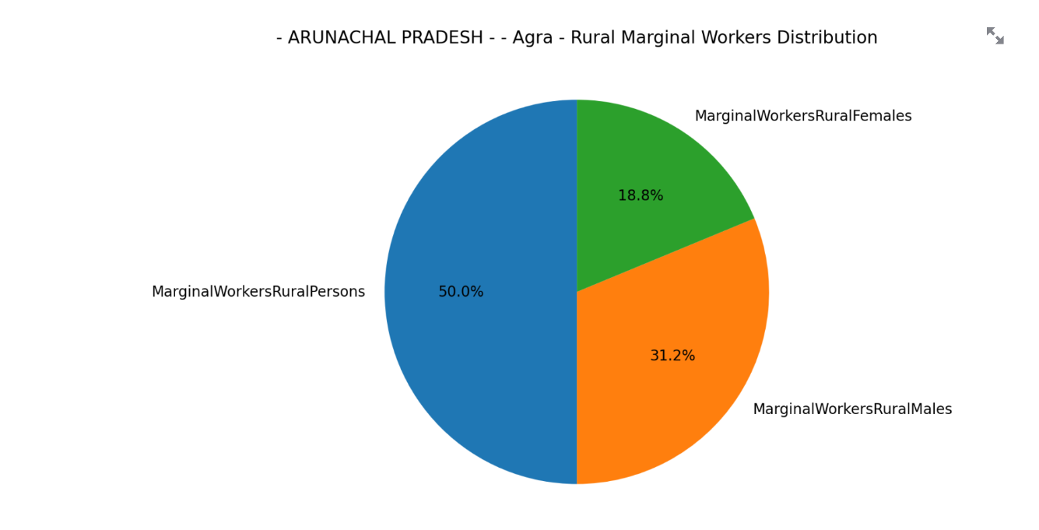

Slide 12
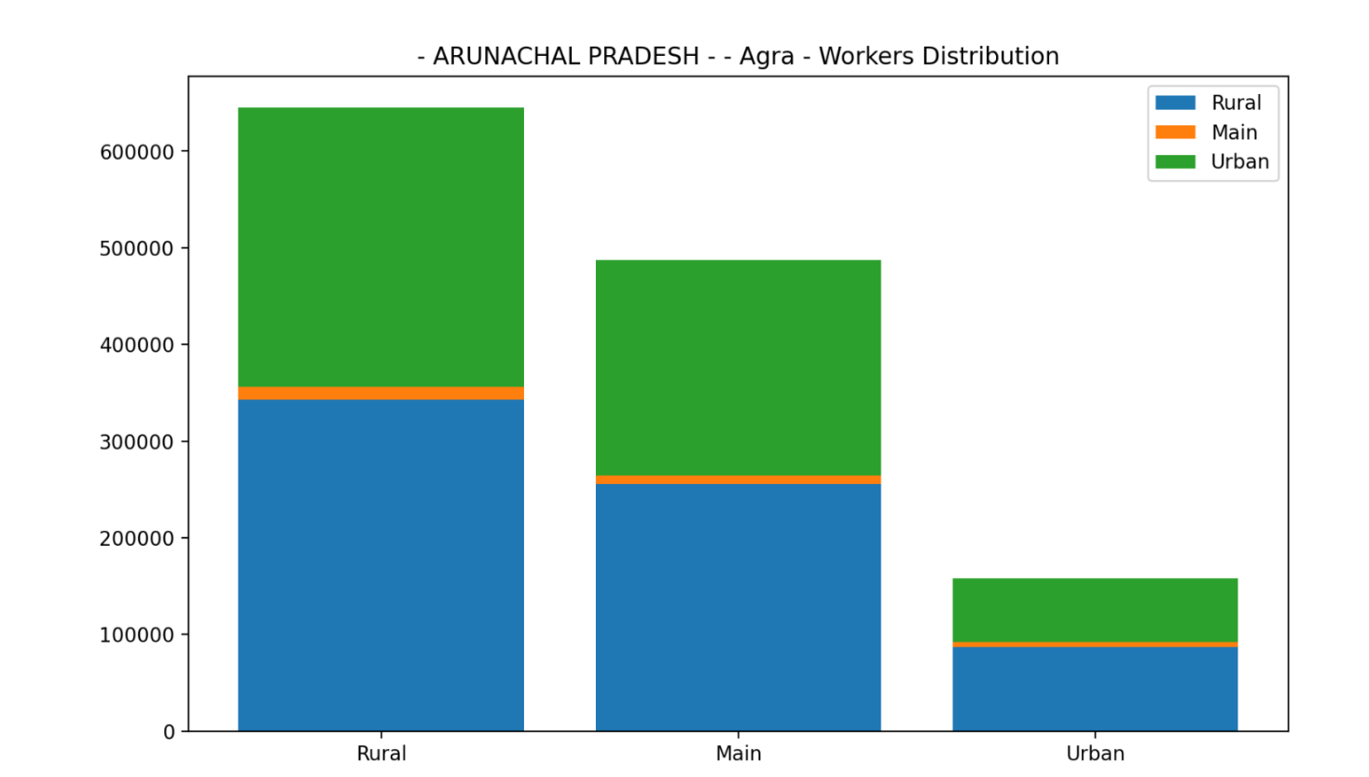

Slide 13
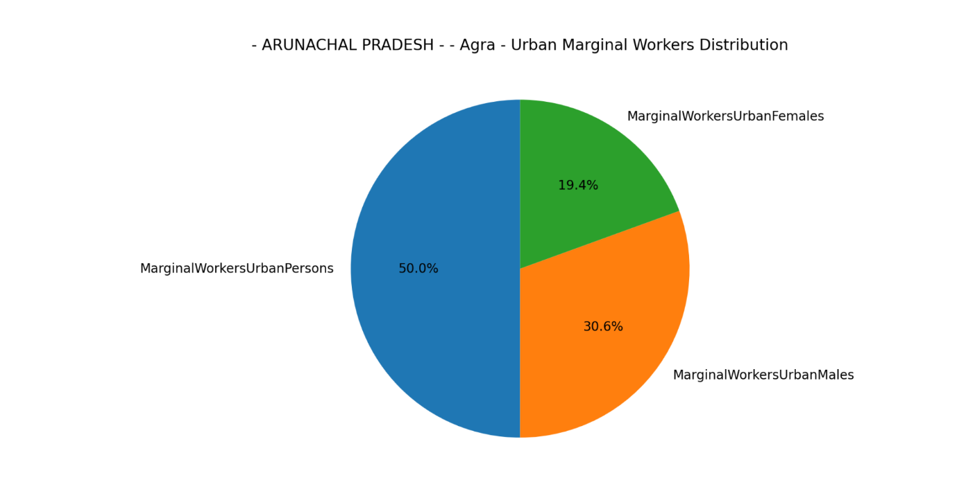

Slide 14
Conclusion
Successfully updated and visualized workforce data to reflect current economic trends.
Provided actionable insights for decision-makers to shape policy, improve workforce distribution, and anticipate labor demands

Slide 15
Thank you

